Slide 1


DINING ETIQUETTE
By,
Varshini Sri | Trainee - CoE

Slide 2
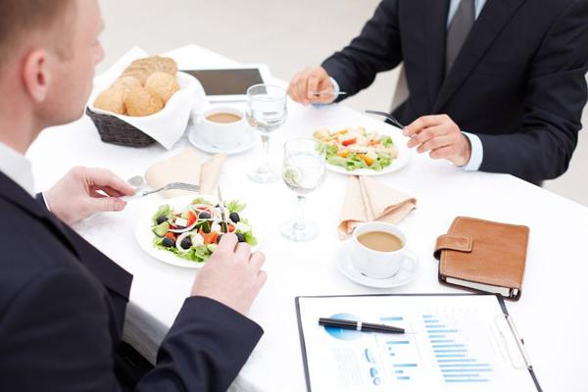
INTRODUCTION
Dining etiquette is the unspoken code of conduct that ensures mealtimes are enjoyable and respectful for all.
From proper table settings to polite conversation, mastering these nuanced social graces can make you a confident and considerate dining companion.

Slide 3

SETTING THE TABLE
Start with a clean, uncluttered table and place the dinner plate in the center.
Position the knife, spoon, and fork in the order they will be used, with the outermost utensil used first.
Place the napkin to the left of the plate or on top of the plate for a more formal setting.

Slide 4

PROPER UTENSIL USAGE
Hold the knife with the blade facing your plate and use it to cut food into bite-sized pieces.
Spoons are used for soups, sauces, and desserts - use the soup spoon for liquids and the teaspoon for anything smaller.

Slide 5
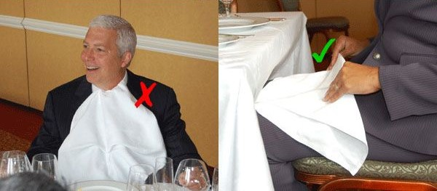
NAPKIN ETIQUETTE
Unfold your napkin and place it on your lap as soon as you sit down.
Blot your lips gently with the napkin throughout the meal, avoiding any dramatic wiping motions.
At the end of the meal, leave the napkin on the table, roughly where your plate was.

Slide 6
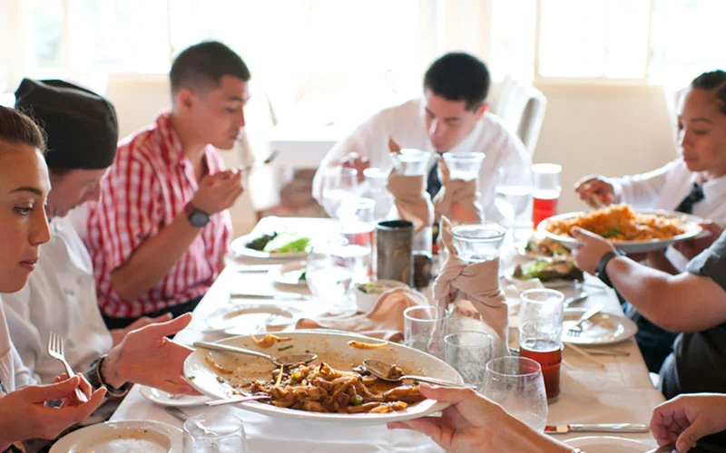
PASSING AND SHARING DISHES
Hold the serving dish with your non-dominant hand, offering it to your neighbor.
Take a moderate portion and pass the dish along.
Use serving utensils provided, rather than your own fork or spoon, to avoid contaminating the shared dish.

Slide 7
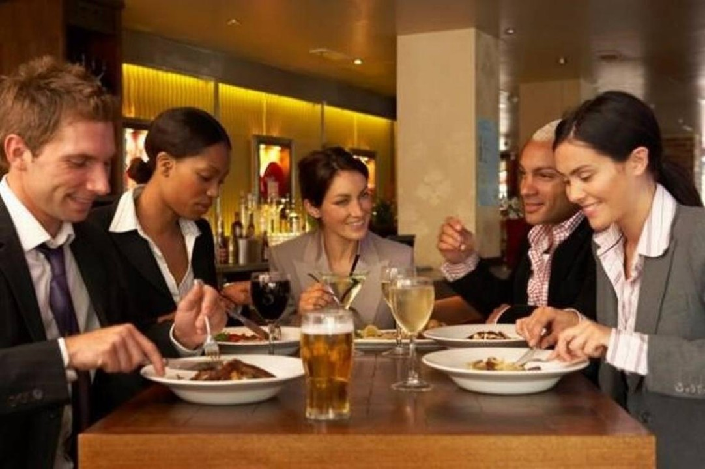
CONVERSATION AT THE TABLE
Engaging in polite conversation is an essential part of dining etiquette.
Avoid sensitive topics, focus on positive subjects, and be an attentive listener.
Share stories and ask questions to keep the dialogue flowing naturally.

Slide 8
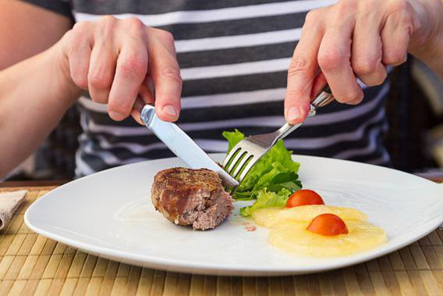
HANDLING DIFFICULT FOODS
Certain foods, like spaghetti, oysters, or sticky rice, can present unique dining challenges.
Use your utensils carefully, avoid messiness, and stay poised.
Slow down, focus, and use your best table manners to navigate these tricky dishes with grace.

Slide 9

DINING IN A GROUP
Etiquette awareness.
Conversational balance.
Shared responsibilities.
Consideration for others.

Slide 10


